Slide 1

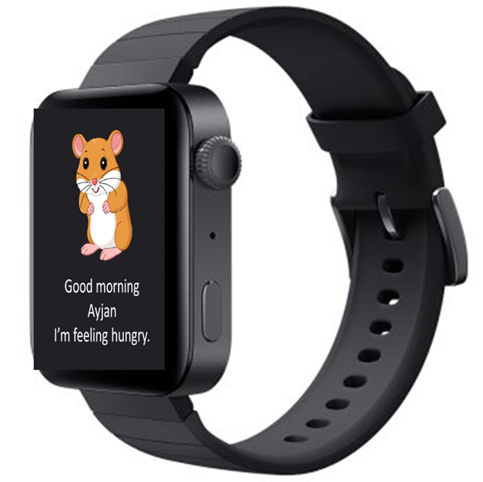

Slide 2
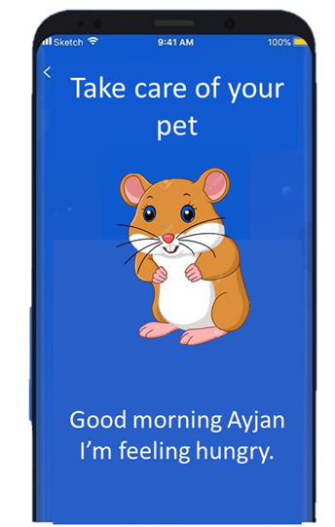
Who’s Sam?

Slide 3
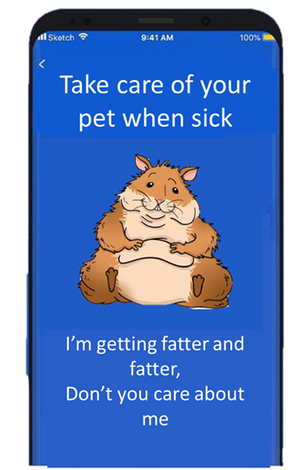

Slide 4
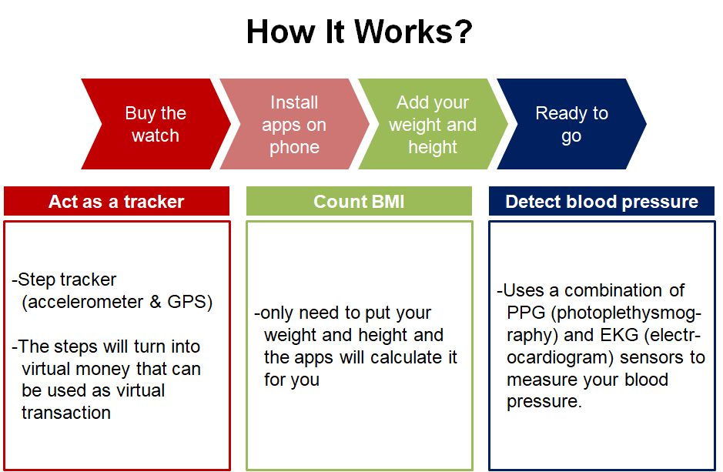

Slide 5



Cheap Price for Students
$50
20%
OFF

Slide 6
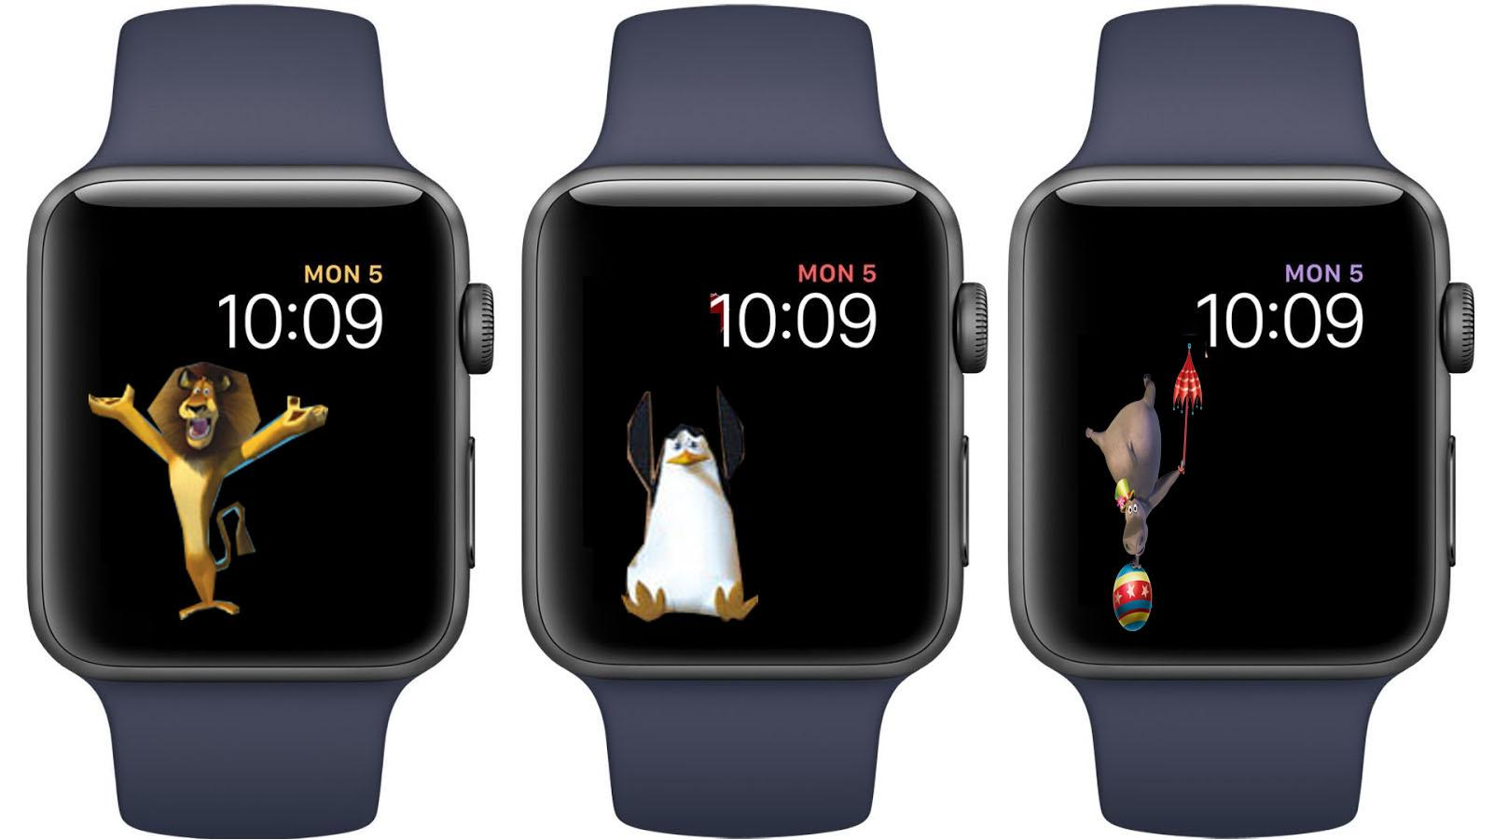

In the Virtual World
You can...
Make your pet healthier
Share energy with your friends all over the world
image: Freepik.com
Notes:
-Can transfer to friends from around the world!

Slide 7

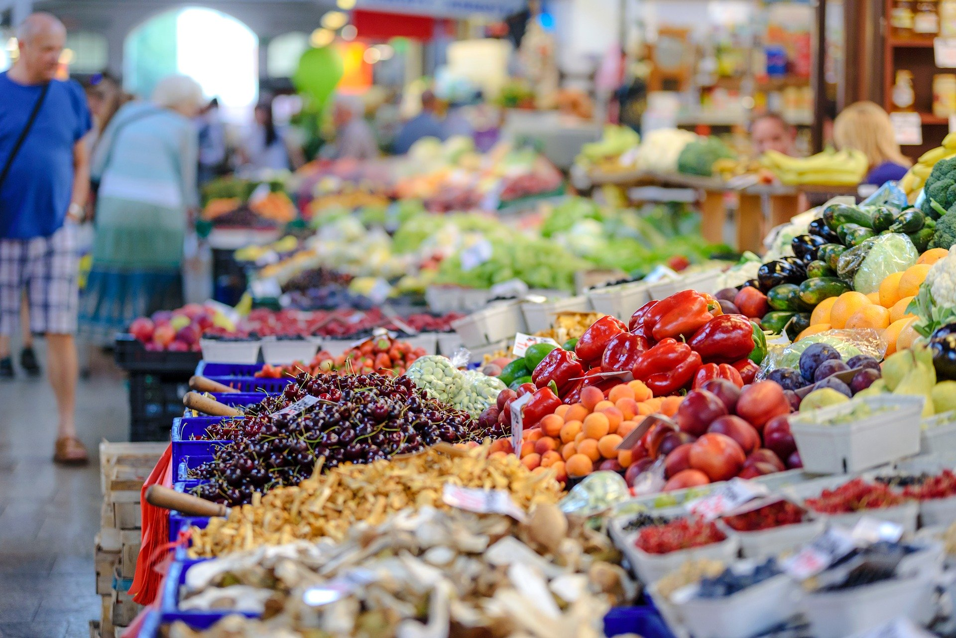
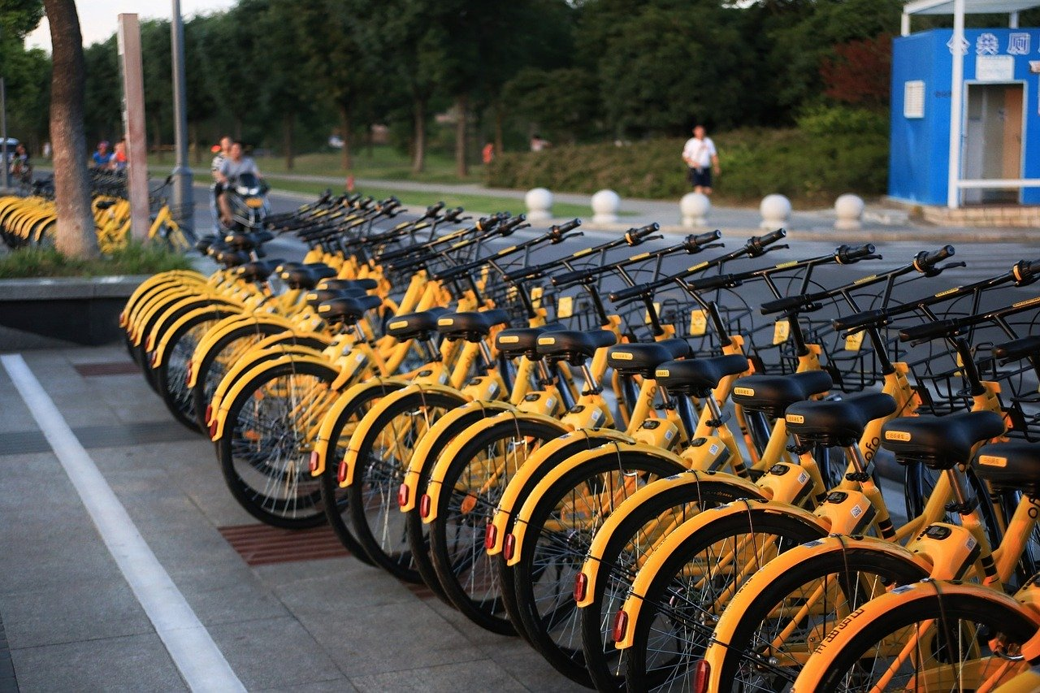
In the Real World
You can get discount on…
Sports shop
Eco shop
Shared bike
Notes:
-Can transfer to friends from around the world!

Slide 8
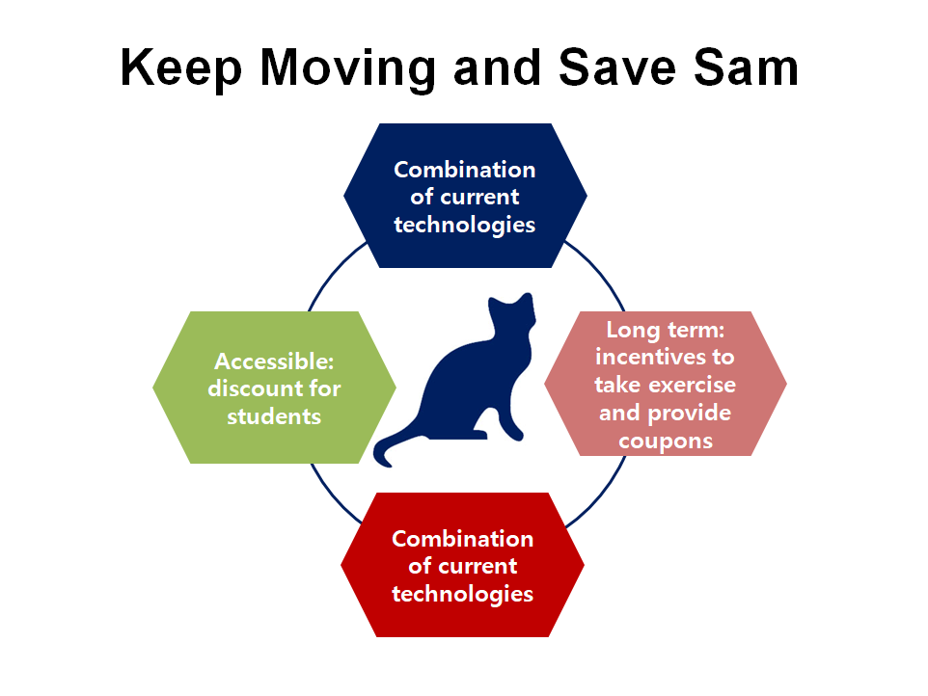

Slide 9
Thank you

Slide 10
